Slide 1



Presented by Alondra Espinoza
ANALYSIS OF SEPHORA PRODUCT REVIEWS
Exploratory data analysis (EDA), Sentiment analysis, Data Visualization

Slide 2


Agenda
Introduction
Company Overview
Dataset Overview
Data Collection and Preparation Exploratory Data Analysis (EDA)
Sentiment Analysis
Key Findings
Proposals
Concerns and Resolutions

Slide 3



Introduction
Alondra Espinoza
Business Data Analytics
International Business Studies

Slide 4


Company Overview
Starting as a fragrance shop, Sephora was founded in 1969 in Limoges, France by Dominique Mandonnaud. Finally getting its name Sephora, in 1995.
Selling a variety of products from cosmetics, perfumes, haircare, skincare, makeup tools and more. Targets beauty enthusiats and a place perfect for testing out a product before purchasing.

Slide 5

Dataset Overview
The dataset I chose contains over 8,000 products sold in Sephora and contains details such as price, brand, reviews, highlights etc. I chose the dataset because I love beauty products since they allow one to express their creativity and I wanted to work on a project where my love for beauty and analytics meet.
Some attributes/insights I have discovered include:
consumer preferences
pricing trends
product sentiment

Slide 6

Data Collection and Preparation
Kaggle: Sephora Products and Skincare Reviews
27 columns, 8494 records
Droppped columns: 9
Kept Columns: product_name, brand_name, loves_count, rating, reviews, size, ingredients, price_usd, limited_edition, online_only, sephora_exclusive, highlights, primary_category, secondary_category, tertiary_category, child_count, child_max_price, child_min_price
Convert type for “Size” from object to float
Standardized categorical columns as boolean values for easier filtering and modeling (limited_edition', 'online_only', 'sephora_exclusive)
Handle missing values

Slide 7


Exploratory Data Analysis (EDA)
After preparing the data, I decided to do some EDA relating to products, brands, highlights, ingredients, loves counts and prices.

Slide 8
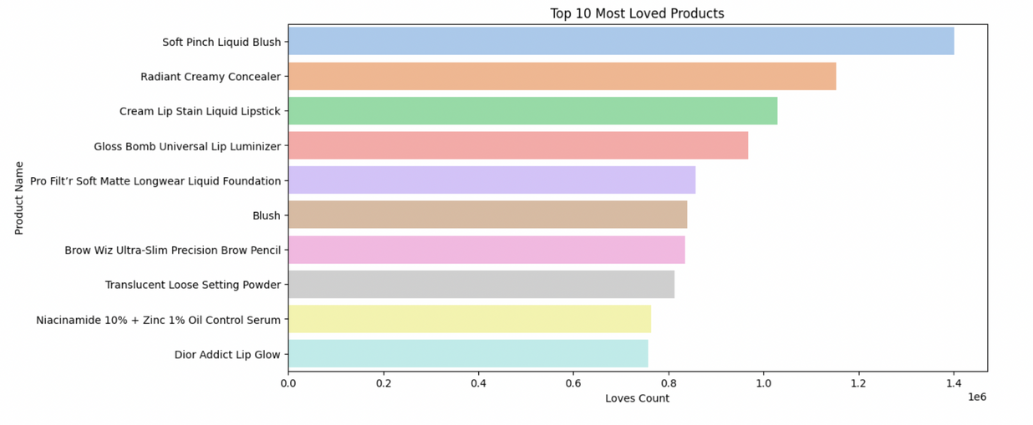
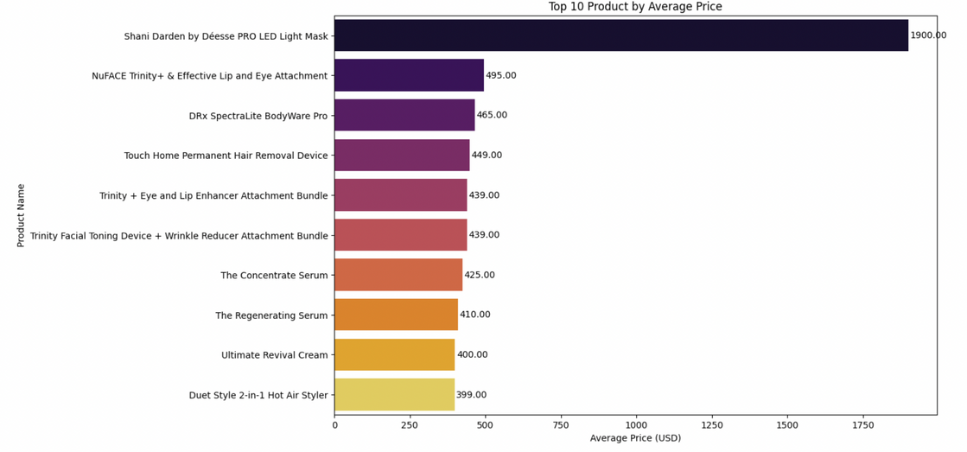
Exploratory Data Analysis (EDA)
Top 10 Most loved products
Soft pinch liquid blush
Radiant creamy concealer
Cream lip stain liquid lipstick
Main point:
Top 10 monst loved products are not the top 10 expensive products.
Top 10 Product by average price
Pro LED light mask
NuFACE Trinity + & Effective Lip and Eye Attachment
Drx SpectraLite BodyWare Pto
Notes:
Price may be scaring consumers away from trying products who have the same ingragdients, highlights

Slide 9
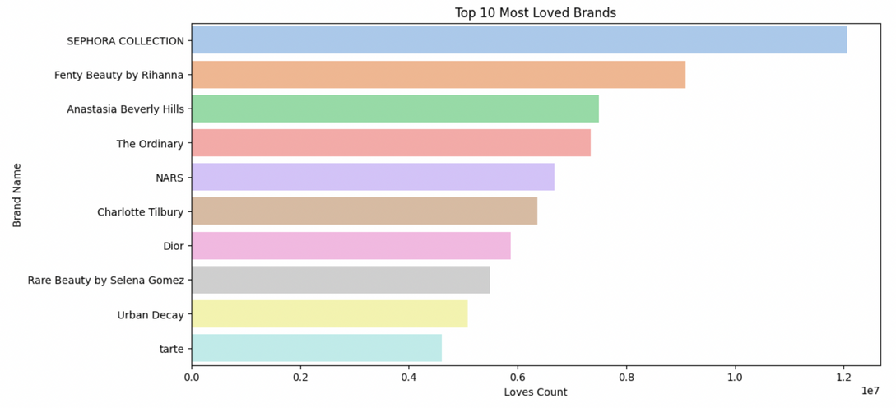
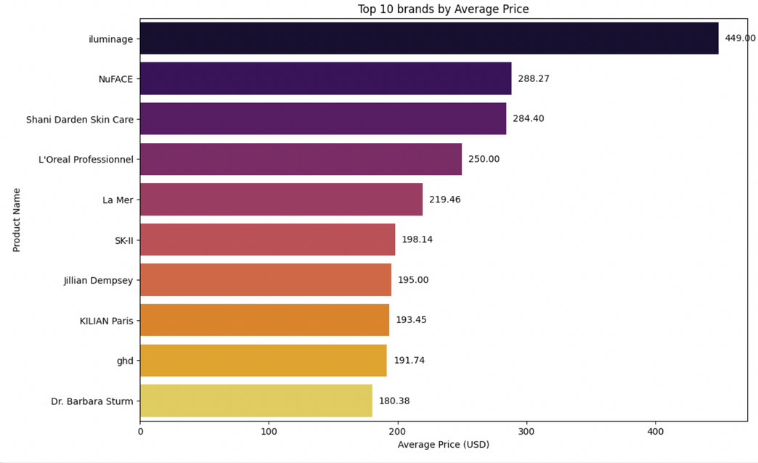
Exploratory Data Analysis (EDA)
Top 10 Most loved Brands
Sephora Collection
Fenty Beauty by Rihanna
Anatasia Beverly Hills
Main point:
Top 10 monst loved Brands are not the top 10 expensive Brands.
Top 10 Brands by average price
Iluminage
NuFACE
Shani Darden Skin Care

Slide 10
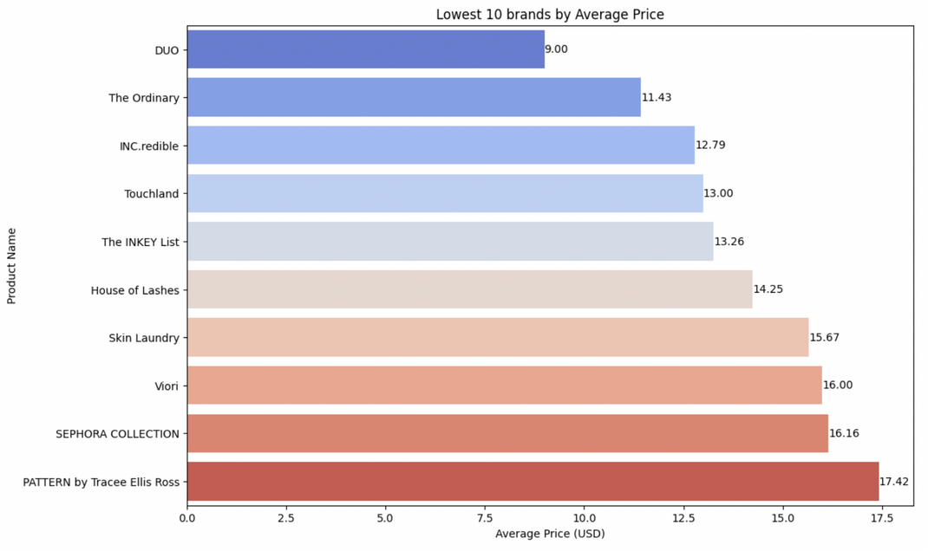
Exploratory Data Analysis (EDA)
Main points:
Common brands are seen between the cheapest and most loved brands.
SEPHORA COLLECTION
The Ordinary
More similarities than when Top loved brands were compared to most expensive brands.
Notes:
Duo is cheapest on average price since it is most likely thier lash glue

Slide 11
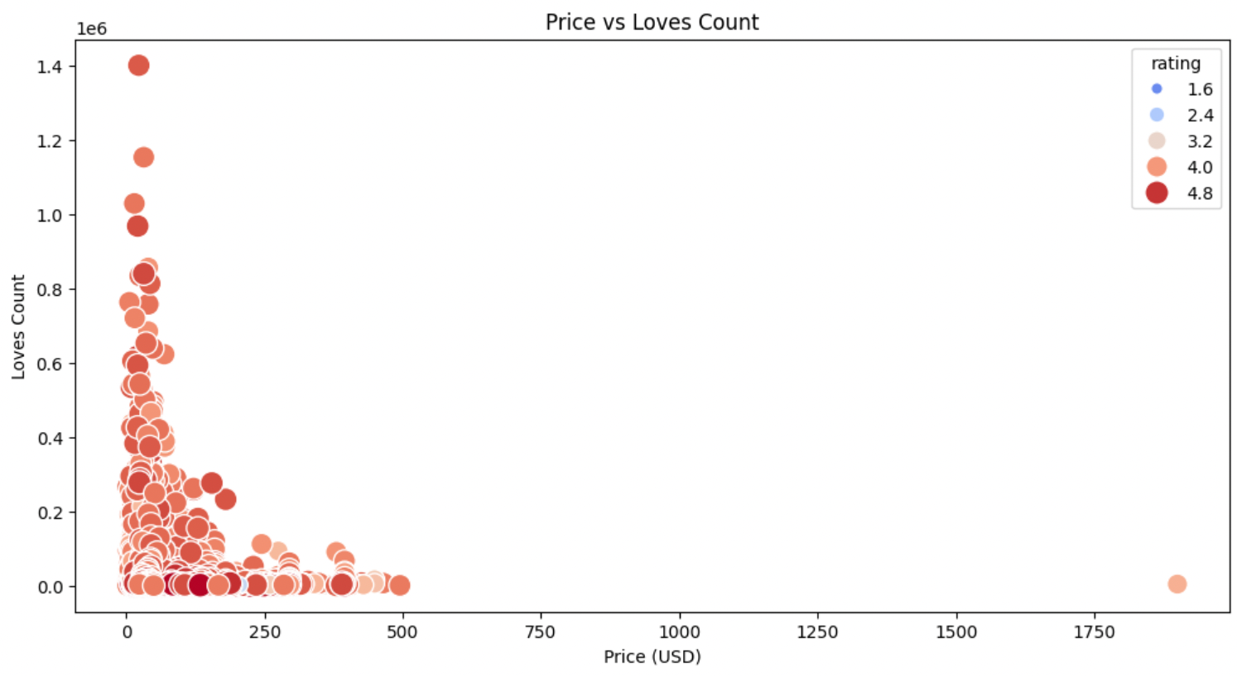
Exploratory Data Analysis (EDA)
Main point:
There seems to be a negative correlation between price and love counts.

Slide 12
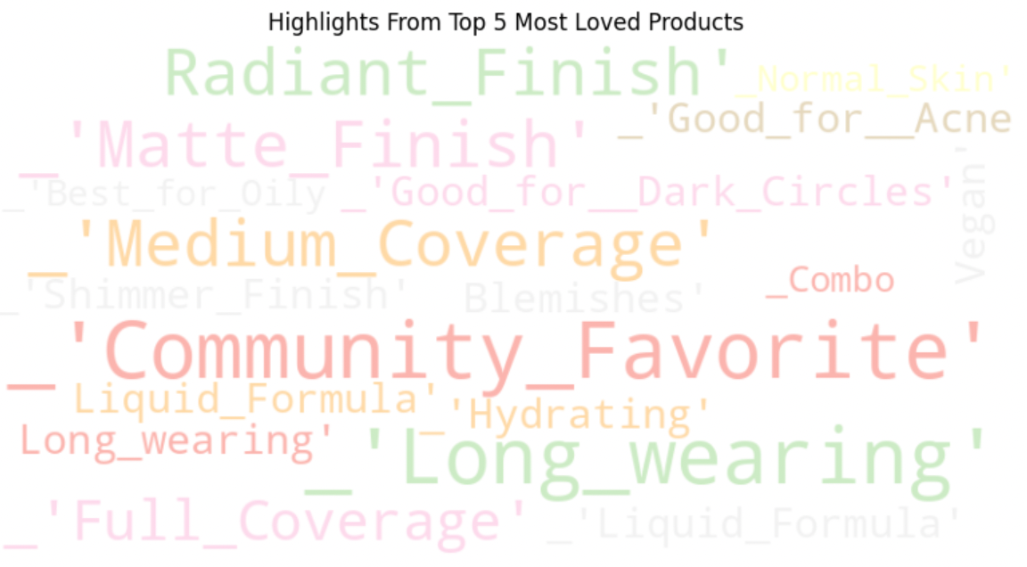
Exploratory Data Analysis (EDA)
Main points:
Prominent highlights seen in most loved products appear to be Community favorite, and Long wearing.
Shows a equal love for matte vs radiant finish and medium vs full coverage
Targets concerns such as Acne, dark circles, and blemishes.

Slide 13
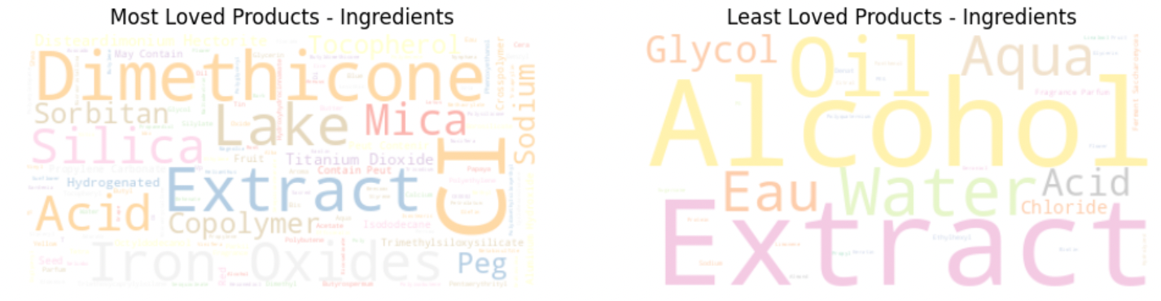
Exploratory Data Analysis (EDA)
Main points:
While the ingredients in the most loved products not too prominent, the ingradients in least loved products are clear to see, with Alcohol, oil, and water being easy to identify.
Since extract is seen in both, there may not be a correlation between most loved and its ingredients.

Slide 14

Sentiment Analysis
Used TextBlob to classify reviews into Positive, Neutral, and Negative categories.
Also classified sentiment based on ratings:
Positive: Ratings ≥ 4.0
Neutral: Ratings between 3.0 and 3.9
Negative: Ratings < 3.0.

Slide 15
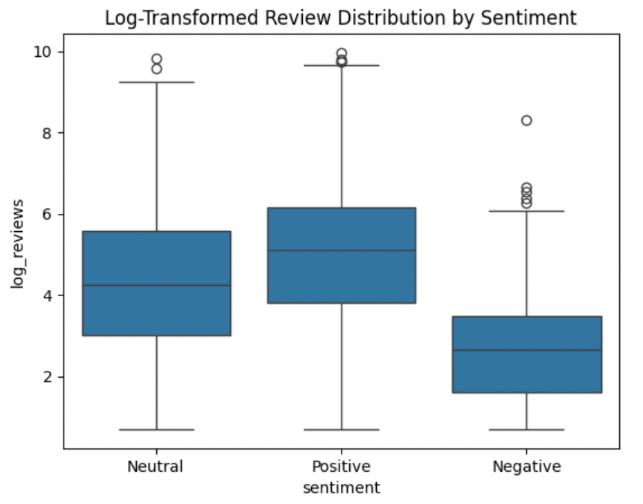
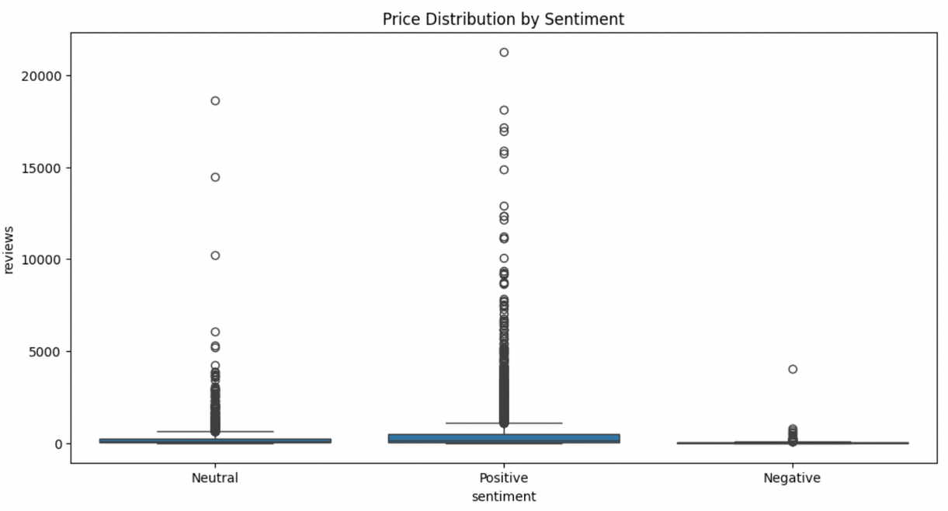
Sentiment Analysis
Main points:
Majority of reviews are Positive (customers generally express satisfaction).
Negative reviews are a smaller fraction but highlight key areas for improvement

Slide 16
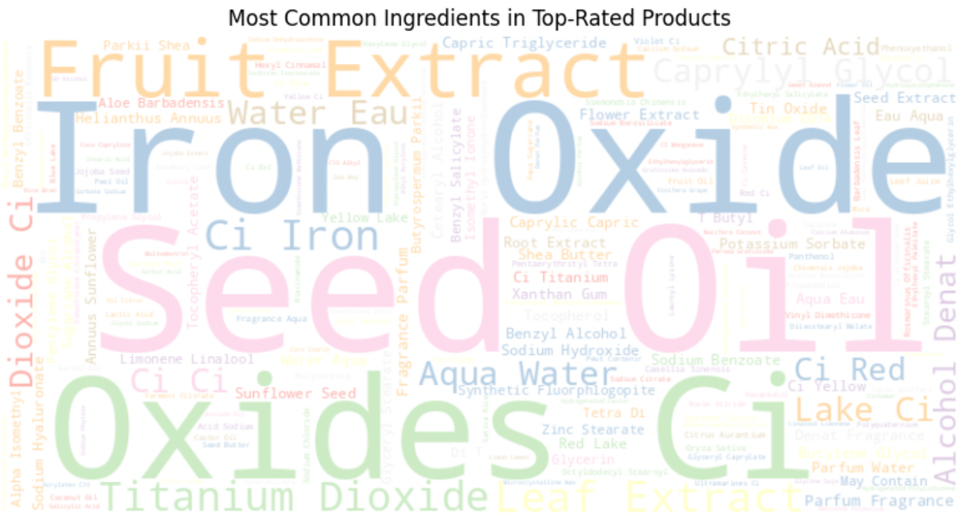
Sentiment Analysis
Main points:
Most common ingredients turn out to be:
Iron
Oxide
Seed Oil
These ingredients seem to be different than the Yop Most Loved.
Yet Ci and Extract are visible in top loved products.

Slide 17

Key Findings
01.
02.
03.
There is a negative correlation between price and love counts.
Ingriendients are mainly distinct between most loved and least loved as well as top rated.
Positively reviewed items have more reviews overall.

Slide 18

Proposals
After my analysis and its visualizations, correlations were more prominent than others.
I have gathered suggestions based on the information of the products and analysis.

Slide 19


01.
A negative correlation between price and love counts may suggest that price may be a big factor in consumer interest. Lowering the product price is not nessesarly the answer here, I suggest promotions or discounts targeting the higher-end products. This would allow for more exposure the higher priced brands and possible create more reviews.
02.
While the word clouds of ingredients didn’t reveal clear drivers of consumer interest, this suggests that no single ingredient guarantees success. Instead, factors like formulation, branding, and consumer experience are key. I suggest marketing the least loved products by emphasizing their unique features, as products with varied ingredients have an equal chance of success.
03.
Since products with the most reviews also tend to have the most positive ratings, brands should focus on encouraging customer reviews to boost engagement and visibility. Strategies like review incentives, social media promotion, and influencer partnerships can help generate more feedback and increase product success."

Slide 20

Concerns and Resolutions
Issue
Solution
Duo was the cheapest brand overall, likely due to its lash glue products. Similarly, tools and devices like LED face masks and beauty blenders may have skewed brand pricing data.
The product highlights are diverse and currently unhelpful in their raw state.
Re-run the analysis excluding tools and devices or conduct a separate analysis for beauty/skincare products and tools/devices to ensure accurate insights.
To gain meaningful insights, it’s necessary to perform sentiment analysis to identify the positive aspects hidden within these highlights and find the most positively associated product features.

Slide 21
THANK YOU!

